Slide 1
Data Science Proposition
Notes:
Hi Team! Thanks for joining me today
Talk about how Data Science, specifically Machine Learning and Neural Networks can help our business
Before we begin I'd like to define some terms in an effort to demistify some concepts that we'll be talking about rather often in the presentation

Slide 2


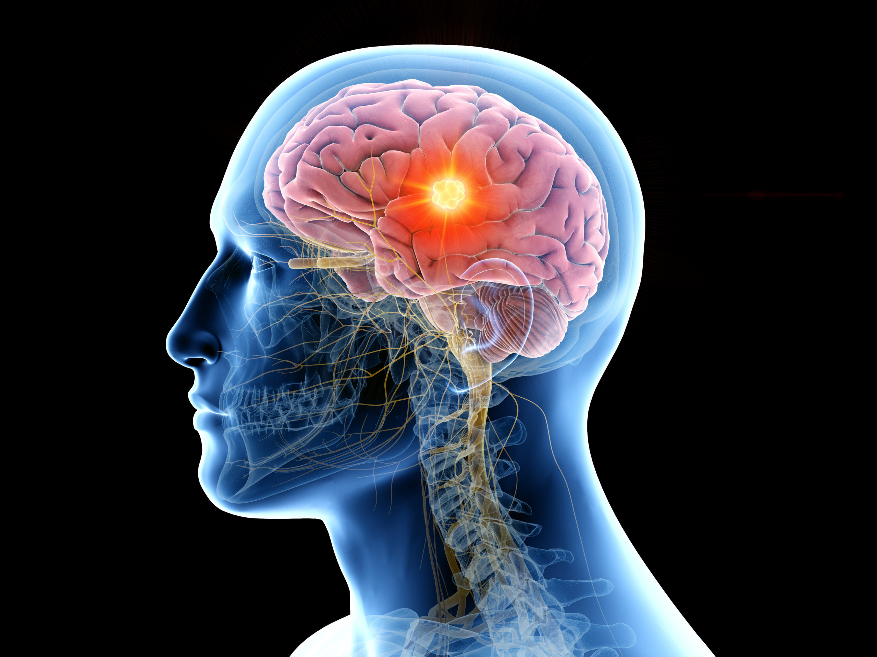
A Few Technical Terms to Get out of the Way
Data Science
The study of the trends and patterns we see in data and how to make predictions with those patterns and trends.
Machine Learning
A way for computers to read trends and patterns quickly and discover those trends and patterns that do best in predicting data
Neural Network
One of the most powerful forms of Machine Learning, that copies the way people think.
Notes:
Data Science is the field of Study
Machine Learning is a way to speed things up
A Neural Network is the fastest way to speed things up

Slide 3

Data Science in Action
Notes:
It's always easier to envision these definitions and as such, I'd like to demonstrate how data science and machine learning work on our own sales data
What makes a data scientist different from a demand planner?

Slide 4
Machine Learning and Neural Nets in Action
Notes:
This is a scatter plot that shows bulleit bourbon's monthly sales over the last 10 years
You can see that the it is trending upwards, but is also starting to plateu

Slide 5

Diageo Supply Chain’s First Data Science Experiment
Remove All Data from April 2018 onwards
Code a Neural Network
Train the Neural Network on Data from 2012 to March 2018
See How well the Neural Network Could Predict F21
Notes:
I wanted to to put machine learning Toe to Toe with our Exec Forecast Process.
Specifically, I wanted to see how well it would do against our March 2018 Exec (my first Exec).

Slide 6
Bulleit Bourbon: Neural Net Vs. Exec Accuracy
Conclusive Metrics
Neural Net out preforms Exec Forecast by 12% in F19, 18% in F20 and 20% in F21
Even during the volatility of COVID 19, the Neural Net was only off by 3.4% vs. the Exec which at 21.2%
Covid 19
Notes:
The Neural Net outpreformed the exec by double digit percentages for the last three years.
But what does that mean from a case volume perspective? and more importantly what does that mean from a Exec Decission perspective?

Slide 7
Potential 10YR Projection Side by Side
Results of Forecast and Subsequent Actions
The Exec Forecast over forecast against actuals by 600k 9Ls from F19 to F21
In 2018 the Exec over forecast against the neural Net by 3.5M 9Ls from F18 to F28
Notes:
The Exec overforecast by 600k cases against actuals
The exec overforecast against the Neural Net by 3.5M Cases from F18 to F28
This led to the construction of Project Workhorse and the Purchase of additional Distilled Liquid
Now its hard to tell how drastically these decisions would have changed, as we would have to revisit all the complex assumptions we had in 2018.
However, we can make a comparison to an updated Neural net and the Exec we ran 4 months ago

Slide 8
Updated F21 Projection Side by Side
Results of Forecast and Subsequent Actions
Forecasts are promisingly similar from F22 to F24
The Exec over forecast against the Neural Net by 3.5M 9Ls fromF22 to F31
Notes:
Forecasts are similar from F22 to F24, but are drastically different from F25 to F31
Again the Exec continues to push for geometric growth throughout the decade and still over forecasts against the Neural Net by 3.5M cases
These decisions are now making us assess the construction of a new distillery, on top of Project Work Horse, to be completed in F26 and for construction next year.
This has also made us cap exports to Japan.

Slide 9
Crown Royal: Neural Net Vs. Exec Accuracy
Conclusive Metrics
Neural Net out preforms Exec Forecast by 5% in F20 and 6% in F21
Even during the volatility of COVID 19, the Neural Net was only off by 8% vs. the Exec which at 13%
Covid 19
Notes:
Exec did a decent job of forecasting, but the Neural Net still outpaced it by 5% in F20 and 6% in F21
You might ask, how impactful is another 5 to 6% more accuracy?

Slide 10
2018 10YR Projection Side by Side
Results of Forecast and Subsequent Actions
The Exec over forecast against actuals by 1M Cases from F19 to F21
The Exec over forecast against the Neural Net by 5.6M 9Ls from F19 to F28
Notes:
Exec Over Forecast against Actuals from F19 to F21 by 1M 9Ls
Exec over forecast against the Neural Net from F19 to F28 by 5.6M 9Ls

Slide 11
Updated F21 Projection Side by Side
Results of Forecast and Subsequent Actions
The Neural Net is picking up on the downward trend seen in previous slides, while the Exec believes it will reverse
The Exec Forecast is reserving 4.2M 9Ls more than the Neural Net.
Notes:
As we had seen in the previous chart, Crown Royal Deluxe is a brand with a downward trend, and it is clear that that the Neural Net believes that trend will continue.
Marketing believes otherwise, and thinks that sales will turn around in F23, and continue to grow in the next decade.

Slide 12
Pause For Questions
?
Notes:
The commensurate effort of the supply chain to support both the short term and long term liquid requirements of Diageo through distillation, maturation and demand management.
We have 5 families of whiskey
Kentucky BBN
Indiana BBN
Tenn Whiskey
Canadian Whisey
CR Deluxe belongs to our Canadian Family of Whiskey

Slide 13
What Do We Need?
A Laptop Capable of Machine Learning
The software environment necessary to code these systems are very specific, and the processing power required to efficiently utilize these algorithms is very large.
Apple has specifically developed its Macbook Pro’s to house Python Libraries, Coding Environments and has even developed a specialized processor that speeds up Machine Learning.
(The Neural Net in this PowerPoint was coded on a Macbook Pro)
AWS Subscription For Cloud Computing
Machine Learning and Neural Networks require a lot of computing power.
The data experiments run by Data Scientists often undergo millions of iterations, and these iterations are done much faster on a cloud computing service.
Already being utilized in Diageo
A Data Scientist
Data Science systems are complex and benefit greatly from being engineered by a group.
It is necessary to have at least two people on the team that can code in python, understand advanced statistics and can act as each other’s back up
Notes:
The commensurate effort of the supply chain to support both the short term and long term liquid requirements of Diageo through distillation, maturation and demand management.
We have 5 families of whiskey
Kentucky BBN
Indiana BBN
Tenn Whiskey
Canadian Whisey
CR Deluxe belongs to our Canadian Family of Whiskey

